Slide 1
LongFormer
By Niharika Pillanagoyala

Slide 2
What is Transformer
Transformer is an architecture for transforming one sequence to another one with the help of two parts called Encoder-Decoder.
Transformer-based models are unable to process long sequences. Ex- BERT is a model limited to 512 tokens at a time.
Due to its self-attention mechanism Transformers scales quadratically with the sequence of words which increases the memory and computational issues.
Drawback : It cannot process long documents due to memory constraint.

Slide 3
LongFormer - Long Document Transformer.
Long Former is a modified Transformer architecture.
The attention mechanism is a drop-in replacement for the standard self-attention and combines a local windowed attention with a task motivated global attention.
It Scales linearly with the sequence length, making it easy to process long tokens in thousands.

Slide 4

Question Answering Tasks – QA is finding correct answer to a given question from some knowledge base.
QA tasks are also divided into domains, depending on where the context for answering the questions can be found:
1. Closed-domain/book Question Answering (cdQA) If the answers are localized to one domain, such as medical.
2. Open-domain/book Question Answering (odQA) If the answers are in multiple domains, general knowledge questions.

Slide 5
Data Set Used: SQuAD – Stanford Questioning Answering Dataset. It has 100k Questions and answers paired from Wikipedia.
Libraries Used :
HuggingFace Transformers – 3.4.0
Pre-trained transformer models
HuggingFace Dataset Library - 1.1.3
To import and manipulate datasets for training and evaluation
Pytorch - 1.7.0
Data Manipulation

Slide 6
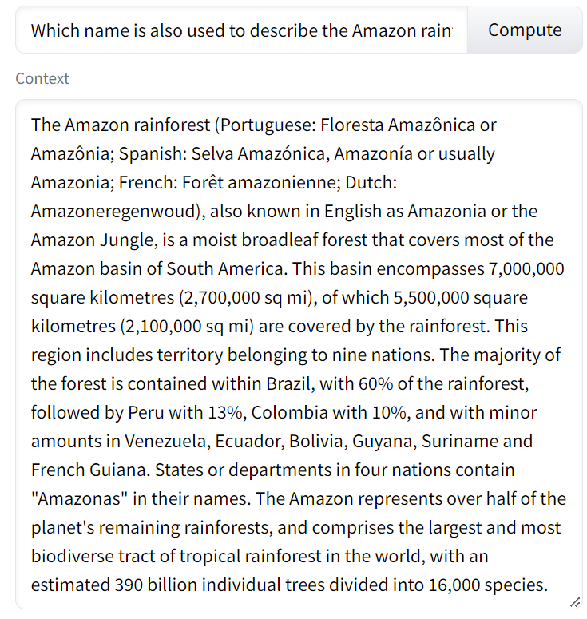


Slide 7
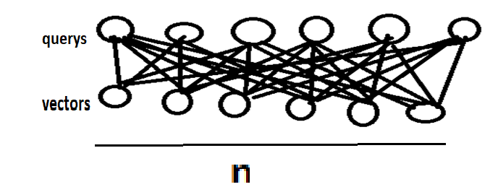
Transformers self Attention
The attention-mechanism looks at an input sequence and decides at each step which other parts of the sequence are important.
O(n 2 )

Slide 8
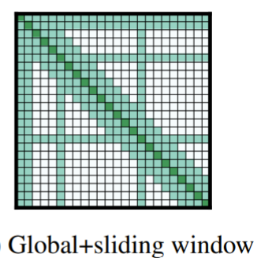
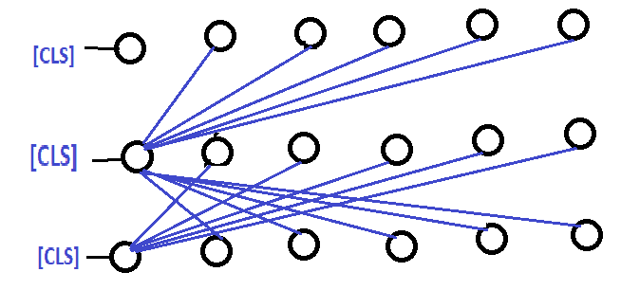
LongFormer uses Global + sliding Window Attention.

Slide 9
Conclusion
Easy to perform wide range of document-level NLP tasks without chunking/shortening the input.
Combines sliding and Global window attention while also scaling linearly with sequence length which reduces the computational complexity.

Slide 10


